Slide 1



Excel for Data Analytics
Opeyemi Fabiyi

Slide 2

Opeyemi Fabiyi
Data Analytics Consultant
Deloitte & Touche

Slide 3
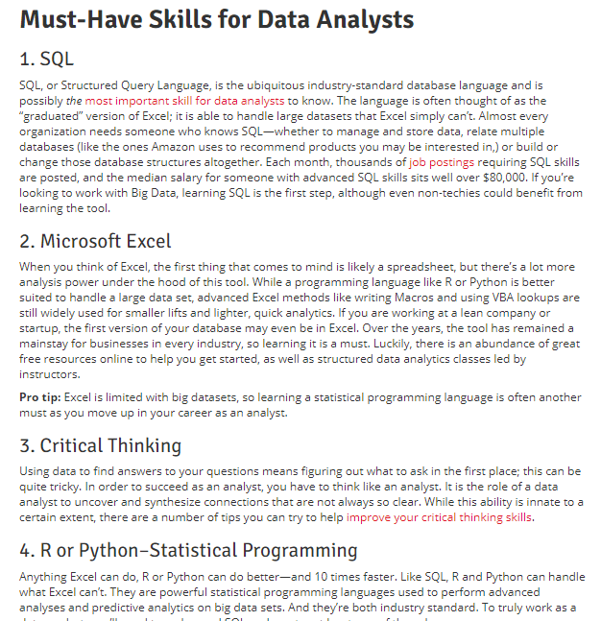
Why Excel?
Northeastern University

Slide 4
Introduction to Excel

Slide 5
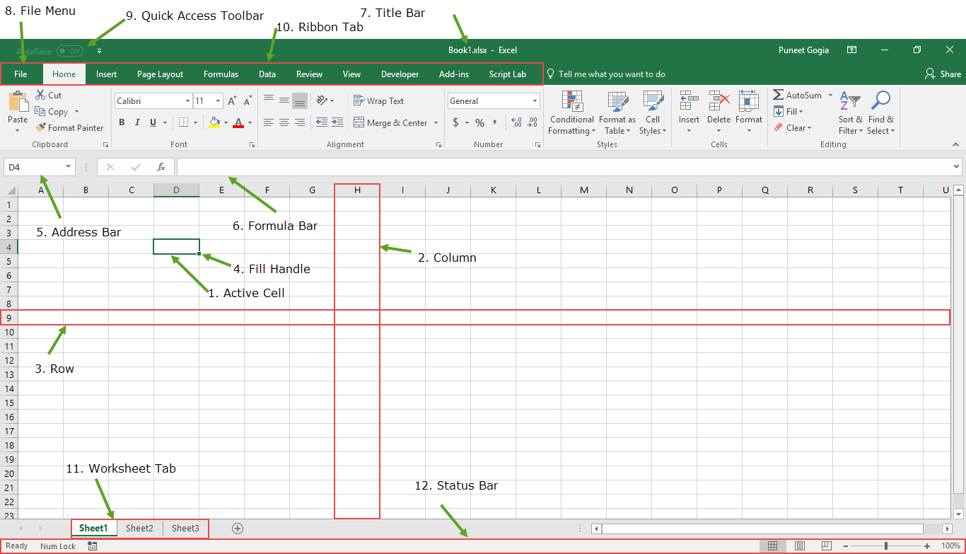
Introduction to Spreadsheets
Active Cell:
A cell which is currently selected. It will be highlighted by a rectangular box and its address will be shown in the address bar. You can activate a cell by clicking on it or by using your arrow buttons. To edit a cell, you double-click on it or use F2.

Slide 6
Introduction to Spreadsheets
Column:
A column is a vertical set of cells. A single worksheet contains 16384 total columns. Every column has its own alphabet for identity, from A to XFD. You can select a column clicking on its header. Column Contains Attributes

Slide 7
Introduction to Spreadsheets
Row:
A row is a horizontal set of cells. A single worksheet contains 1048576 total rows. Every row has its own number for identity, starting from 1 to 1048576. You can select a row clicking on the row number marked on the left side of the window. Row contains records

Slide 8
Introduction to Spreadsheets
Fill Handle:
It’s a small dot present on the lower right corner of the active cell. It helps you to fill numeric values, text series, insert ranges, insert serial numbers, etc.

Slide 9
Introduction to Spreadsheets
Address Bar:
The address bar is the small input bar at the left side of the window. It shows the address of the active cell. If you have selected more than one cell, then it will show the address of the first cell in the range.

Slide 10
Introduction to Spreadsheets
Formula Bar:
Formula bar is an input bar, below the ribbon. It shows the content of the active cell and you can also use it enter a formula in a cell.

Slide 11
Introduction to Spreadsheets
File Menu:
The file menu is a simple menu as like all other applications. It contains options like (Save, Save As, Open, New, Print, Excel Options, Share, etc).

Slide 12
Introduction to Spreadsheets
Quick Access Toolbar:
A toolbar to quickly access the options which you frequently use. You can add your favourite options by adding new options to quick access toolbar.

Slide 13
Introduction to Spreadsheets
Ribbon Tab:
Starting from the Microsoft Excel 2007, all the options menus are replaced with the ribbons. Ribbon tabs are the bunch of specific option group which further contains option.

Slide 14
Introduction to Spreadsheets
Status Bar:
It is a thin bar at the bottom of the Excel window. It will give you an instant help once you start your working in Excel.

Slide 15
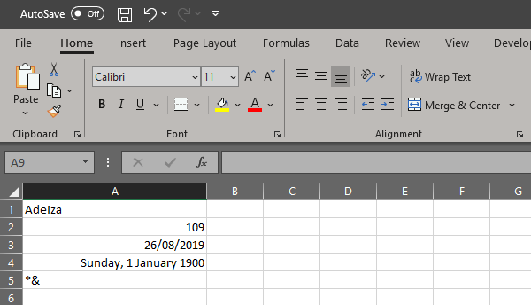
Introduction to Spreadsheets
Texts always align to the left
Numerical Values align to the right
Dates are also numbers and align to the left
This is also a date
Symbols are also related as texts in Excel except when used in a formula
To change the format in Excel use this shortcut: Ctrl + 1

Slide 16
Introduction to Spreadsheets
Use Shortcuts (1/2)
F2 – Enter into a cell
F4 – Repeats last command (or Anchor if within a cell)
ESC – Exit a cell without making any changes
Enter – Moves down a cell
Tab – Moves right a cell
Ctrl, Z – Undo
CTRL, D – Fill Down
CTRL, R – Fill Right
Ctrl, (Up, Down, Left or Right) – Moves to first/last non-empty cell in range
Shift, Ctrl (Up, Down, Left or Right) – Highlights up until last non-empty cell in range
Ctrl, Home – Moves to Cell A1 (unless another home cell has been defined)
Ctrl, PgUp/Dn – Moves between worksheets within workbook
Alt, Down – Opens a drop down list
Ctrl, Tab – Flips between open files of the same program

Slide 17
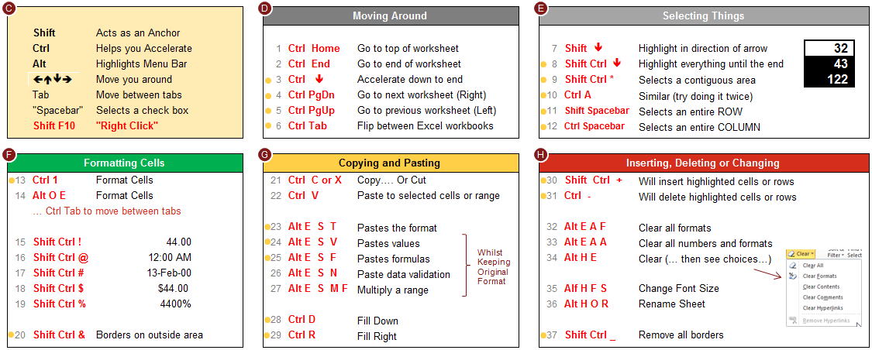
Introduction to Spreadsheets
Use Shortcuts (2/2)

Slide 18
Paste Special
1

Slide 19
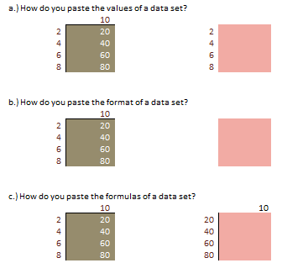
Introduction to Spreadsheets
Paste Special
Ctrl + Alt + V
D9*C10 (Copying this cell and pasting here will paste the formula, but we need the value
To copy the value:
Copy the cell (Ctrl C)
Ctrl + Alt + V (Paste Special)
Select Values and press OK
To copy the format:
Copy the cell (Ctrl C)
Ctrl + Alt + V (Paste Special)
Select Formats and press OK
To copy the formulas:
Copy the cell (Ctrl C)
Ctrl + Alt + V (Paste Special)
Select Formulas and press OK

Slide 20
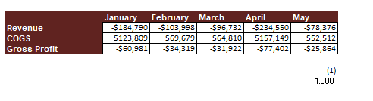
Introduction to Spreadsheets
Advanced Paste Special
Ctrl + Alt + V
Using the Paste Special multiply feature, change the sign of the Revenue & COGS row
Copy negative 1
Select the values in Revenue and COGS
Open Paste Special Ctrl + Alt + V
Select the multiply option
Press Ok

Slide 21
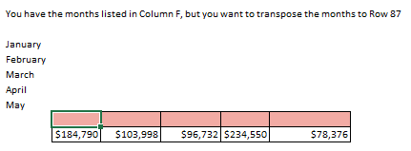
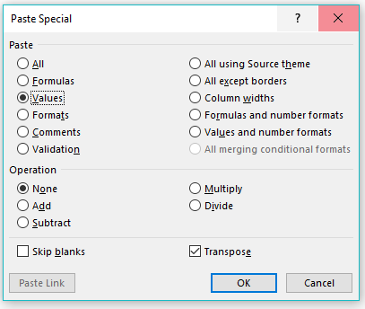
Introduction to Spreadsheets
Advanced Paste Special
Ctrl + Alt + V
Copy the months
Click on the cell where you want to paste
Open Paste Special Ctrl + Alt + V
Select the values
Select the transpose
Press Ok

Slide 22
Cell Referencing
2

Slide 23
Cell Referencing
Relative cell references
It does not contain dollar signs in a row or column, e.g. A2
Relative cell references type in excel change when a formula is copied or dragged to another cell, In Excel, cell referencing is relative by default, it is the most commonly used cell reference in the formula.

Slide 24
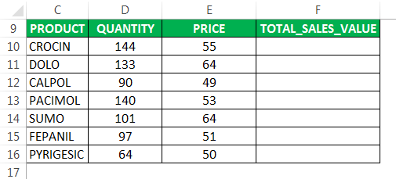
Cell Referencing
Relative cell references
To calculate the total sales for each item, I need to multiply the price of each item with the quantity
The formula in cell F10 would be multiplication in excel – D10*E10.

Slide 25
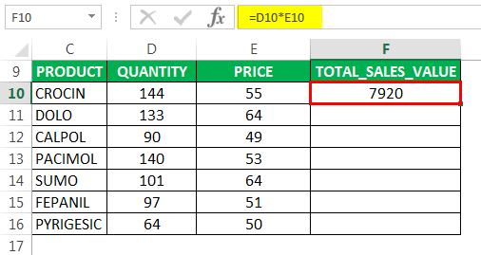
Cell Referencing
Relative cell references
It returns the total sales value.

Slide 26
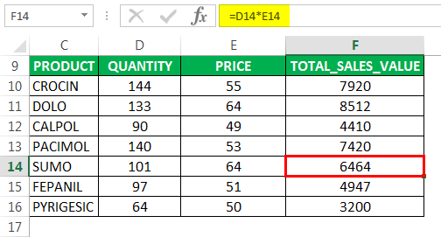
Cell Referencing
Relative cell references
To check a relative reference, select any of the cells of Total sales value in column F and you can view the formula in the formula bar

Slide 27
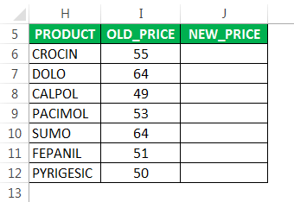
Cell Referencing
Absolute cell references
In the below mentioned Pharma product table, it contains medicine products in column H (H6:H12) and its old price in column I (I6:I12) & New price in column J which I need to find out with the help of Absolute Cell Reference.

Slide 28
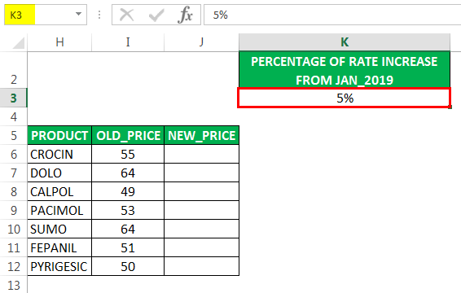
Cell Referencing
Absolute cell references
The rate increase for each product is 5% effective from Jan 2019 and is listed in cell “K3”.

Slide 29
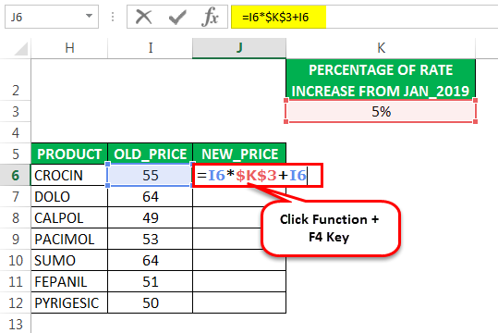
Cell Referencing
Absolute cell references
To calculate the new price for each item, I need to multiply the old price of each item with the percentage price increase (5%) and add old price to it.
Let check out for the first item, For the first item, the formula in cell J6 would be =I6*$K$3+I6, where it returns new price

Slide 30
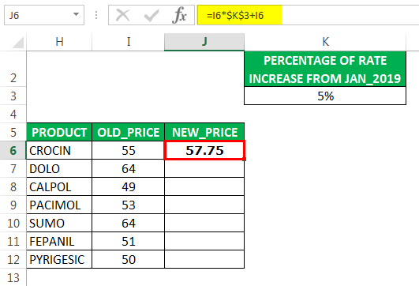
Cell Referencing
Absolute cell references
Here the percentage rate increase for each product is 5%, which is a common factor. Therefore, we have to add dollar symbol, in front of the row and column number for the cell “K3”, to make it absolute reference i.e. $K$3, it can be added by clicking function+f4 key once.
Here dollar sign for the cell “K3” fixes the reference to a given cell, where it remains unchanged no matter when you copy or apply a formula to other cells.

Slide 31
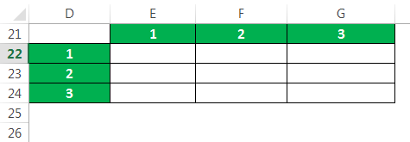
Cell Referencing
Mixed cell references
In the below-mentioned table. I have values in each row (D22, D23 & D24) & columns (E21, F21 & G21), here I have to multiply Each column with each row with the help of Mixed Cell Reference Type in Excel.

Slide 32
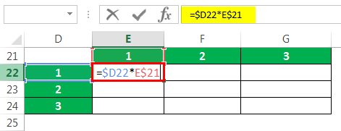
Cell Referencing
Mixed cell references
There are two types of mixed cell references can be used here to get the desired output

Slide 33
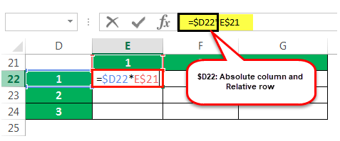
Cell Referencing
Mixed cell references
$D22: Absolute column and Relative row
Here dollar sign before column D indicates, only row number can change, whereas the column letter D is fixed, it doesn’t change.
when you copy the formula to the right side, the reference will not change because it is locked, but When you copy it down, the row number will change, because it is not locked

Slide 34
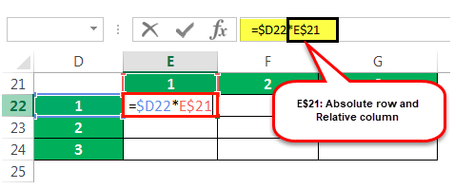
Cell Referencing
Mixed cell references
E$21: Absolute row and Relative column
Here dollar sign right before the row number, indicates only column letter E can change, whereas the row number is fixed, it doesn’t change.
when you copy the formula down, the row number will not change, because it is locked but When you copy the formula to the right side, the column alphabet will change, because it is not locked

Slide 35
Named Range
3

Slide 36
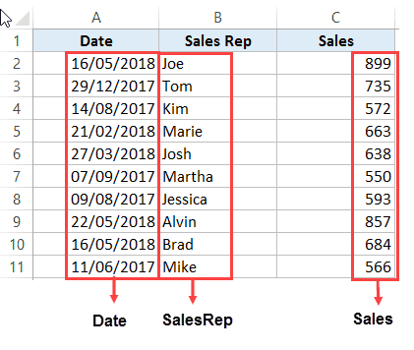
Named Ranges
Named Ranges
By using names, you can make your formulas much easier to understand and maintain. You can define a name for a cell range, function, constant, or table. Once you adopt the practice of using names in your workbook, you can easily update, audit, and manage these names.

Slide 37
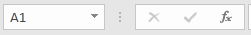
Named Ranges
Named Ranges
Select the range you want to name, including the row or column labels.
In the Name Box, type a name.
Press Enter.

Slide 38

Named Ranges
No Need to Go Back to the Dataset to Select Cells
Another significant benefit of using Named Ranges in Excel is that you don’t need to go back and select the cell ranges.

Slide 39
Data Cleansing
4

Slide 40

Data Cleaning
W need to clean our data to remove unwanted objects and put it in the right structure

Slide 41
Clean
5
=Clean(Text)

Slide 42
CLEAN function
Overview
Syntax
The CLEAN function removes all nonprintable characters from text
The CLEAN function looks at a value in one cell, and removes nonprintable characters
=CLEAN(Text)
=CLEAN(Value you want specific character removed from)
Uses and Applications
Tips and Tricks
Cleaning large data sets
Removing extra characters that are unwanted in specific cells or a range of cells
Can be nested with other data cleansing formulas (I.e. Trim, Value)

Slide 43
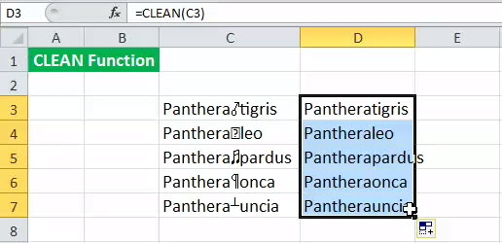
Clean Function
=clean(text)
The CLEAN in Excel is used to pre-process file/text which is imported from other applications and contains characters that are not printable/readable with the current application.
Imported data from databases, text files or web pages usually contain such characters. These characters may lead to an error when given as input to some functions. Before analyzing such imported data, it needs to be cleaned up

Slide 44
Trim
5
=trim(Text)

Slide 45
TRIM function
Overview
Syntax
The TRIM function removes all spaces from a string (with the exception of single spaces between words)
=TRIM(Text)
=TRIM(Value you want the spaces removed from)
Uses and Applications
Tips and Tricks
Use TRIM on text that you have received from another application that may have irregular spacing
Can be nested with other data cleansing formulas (i.e. Clean, Value)

Slide 46
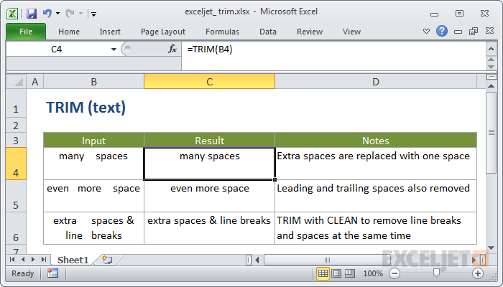
Trim Function
=trim(text)

Slide 47
Substitute
6
=SUBSTITUTE (text, old_text, new_text, [instance])

Slide 48
SUBSTITUTE function
Overview
Syntax
The SUBSTITUTE function substitutes new_text for old_text in a text string
=SUBSTITUTE(Text, Old_Text, New_Text, Instance_num)
=SUBSTITUTE(Text or reference to text you want to substitute characters, text you want to replace, the text you want to replace old text with, (Optional) Specifies with instance of old text you want to replace with new text)
Uses and Applications
Tips and Tricks
Use SUBSTITUTE when you want to replace specific text in a text string
Use quotes around text strings

Slide 49
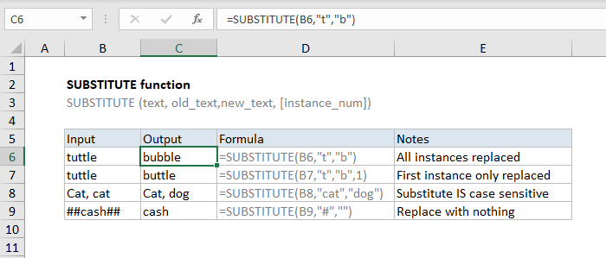
Substitute
=SUBSTITUTE (text, old_text, new_text, [instance])

Slide 50
Value
7
=value(text)

Slide 51
VALUE function
Overview
Syntax
The VALUE function converts a text string that represents a number into a number
The text enclosed in quotation marks or a reference to a cell containing the text you want to convert
=VALUE(Text)
=VALUE(Cell to be converted)
Uses and Applications
Tips and Tricks
Text can be in any of the constant number, date, or time formats recognized by Microsoft Excel
Generally you do not need to use the VALUE function in a formula because Excel automatically converts text to numbers as necessary

Slide 52
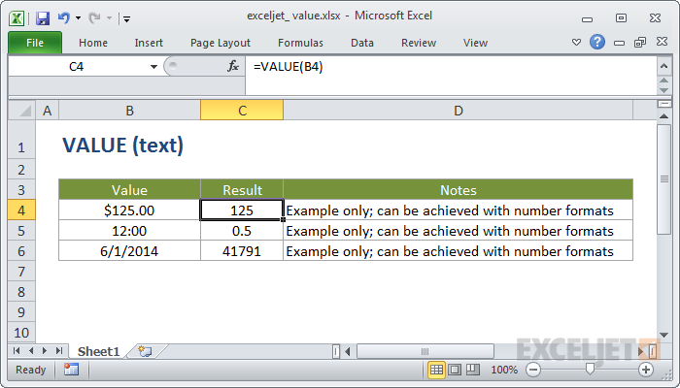
Value
The Excel VALUE function converts text that appears in a recognized format (i.e. a number, date, or time format) into a numeric value.

Slide 53
De-Duplicating
8

Slide 54
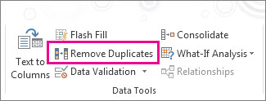
De-Duplicating
To remove duplicate values, click Data > Data Tools > Remove Duplicates.
Check before removing duplicates: Before removing duplicate values, it's a good idea to first try to filter on

Slide 55
VLOOKUP
9

Slide 56

VLOOKUP

Slide 57
VLOOKUP
VLOOKUP (lookup_value, table_array, col_index_num, [range_lookup])
VLOOKUP (value you want to look up more information around, table you want to look up from, column you want to return from, false)

Slide 58
VLOOKUP
Overview
VLOOKUP functions allow to look up a value you want to find in an Excel list or table
VLOOKUP function looks at a value in one column and finds its corresponding value on the same row in another column.
VLOOKUP stands for vertical, which means the data in the table must be arranged vertically, with data in rows.
Uses and Applications
Tips and Tricks
Table or data must be structured
Always finds the first match
Named ranges make VLOOKUP easier to read (and more portable)
#N/A! error is displayed when text not found
Searching among structured datasets
Combine with other function to extract specific information

